Slide 1
SECURE DATA HIDING IN IMAGES USING STEGANOGRAPHY
CAPSTONE PROJECT
Presented By:
Student Name : Kudumala Ganga Siva Sai Reddy
College Name & Department : Siddharth Institute of Engineering and Technology & ECE

Slide 2
OUTLINE
Problem Statement
Technology used
Wow factor
End users
Result
Conclusion
Git-hub Link
Future scope

Slide 3
Problem Statement
With the rise of digital communication, securing sensitive information is a growing challenge. Traditional encryption methods can attract attention, making hidden data an appealing alternative. Steganography embeds secret data within images, ensuring discreet transmission without raising suspicion. However, existing techniques often struggle with limited capacity, image distortion, and susceptibility to attacks. This project aims to develop a secure and efficient steganographic method that enhances data embedding capacity while maintaining image quality and robustness.

Slide 4
Technology used
The main technologies used here are :
Python
OpenCV – Library for image processing and manipulation.
Stegano – A Python library for simple LSB-based steganography.
Cryptography – If encryption is applied before hiding data.
The tools used are :
Python IDLE
Visual Studio Code or Jupyter Notebook (Optional).

Slide 5
Wow factors
1️⃣ AI-Powered Steganography
🔹 Use Deep Learning (CNNs) to enhance steganography techniques, making data embedding smarter and harder to detect. 🔹 Implement autoencoder-based steganography to hide data more efficiently with minimal image distortion.
2️⃣ Dual-Layer Security
🔹 Encrypt the hidden data before embedding using AES or RSA encryption. 🔹 Combine Steganography + Watermarking for an extra layer of security.
3️⃣ Adaptive Steganography
🔹 Use image content analysis to determine the best embedding locations, reducing distortions. 🔹 Implement dynamic LSB substitution instead of traditional static embedding, making detection harder.
4️⃣ Real-Time Steganography Detector
🔹 Add a steganalysis module that checks whether an image contains hidden data. 🔹 Use AI-based classification to detect tampered or stego images.
5️⃣ Cross-Platform & Cloud Integration
🔹 Develop a web-based tool (using Flask/Django) for users to hide & extract secret messages online. 🔹 Implement cloud storage integration to securely share stego images.

Slide 6
End users
There are many end users from various sectors based on follows:
1️⃣ Government & Defense Agencies
🔹 Military & Intelligence Services – To securely transmit confidential information without attracting attention. 🔹 Law Enforcement – For covert investigations and secure communication between agencies.
2️⃣ Journalists & Whistleblowers
🔹 Investigative Journalists – To discreetly share sensitive data without risk of interception. 🔹 Whistleblowers – To send information without being tracked by organizations or authorities.
3️⃣ Cybersecurity Professionals
🔹 Ethical Hackers & Penetration Testers – To test steganographic methods against detection. 🔹 Cryptography Experts – To enhance encryption and steganography-based security models.
4️⃣ Corporate & Financial Sectors
🔹 Banks & Financial Institutions – For secure transmission of confidential data like transaction records. 🔹 Companies Handling IP (Intellectual Property) – To prevent data leaks and industrial espionage.
5️⃣ General Users & Privacy Advocates
🔹 Individuals Concerned About Privacy – For personal secure communication. 🔹 Artists & Content Creators – To watermark digital assets and prevent unauthorized use.

Slide 7
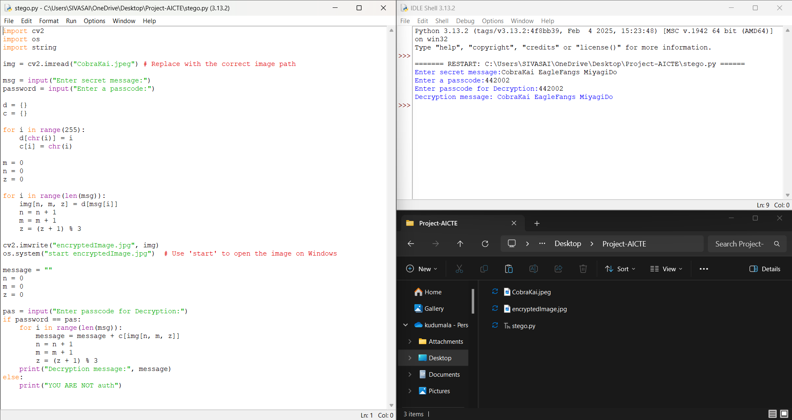
Results

Slide 8
Conclusion
In an era where digital security is paramount, steganography provides a powerful method for covert data transmission by embedding information within images. This project successfully implements a secure and efficient data-hiding technique that enhances confidentiality while maintaining image quality. By integrating encryption, adaptive embedding, and robust detection resistance, the system ensures improved security against steganalysis attacks. The proposed method can be applied in various fields, including cybersecurity, defense, and private communications. Future enhancements can focus on AI-powered steganography and cross-platform integration to further strengthen data security in the evolving digital landscape.

Slide 9
GitHub Link
https://github.com/Sivasaireddy04/AICTE-Project

Slide 10
Future scope
1️⃣ AI-Powered Steganography
Use Deep Learning (CNNs & GANs) to create adaptive steganography methods that intelligently embed data while minimizing detection risks.
Implement autoencoder-based techniques for more efficient and undetectable hiding.
2️⃣ Quantum-Secure Steganography
Explore quantum cryptography to enhance security against future quantum computing threats.
Develop quantum-resistant encryption for hidden data.
3️⃣ Enhanced Steganalysis Resistance
Improve robustness against AI-based steganalysis tools by randomizing embedding patterns.
Implement multi-layer steganography by hiding data across different colour channels and image regions.
4️⃣ Cross-Platform & Real-Time Applications
Develop mobile apps & web-based platforms for easy access to steganographic encoding and decoding.
Integrate with cloud services for secure sharing and retrieval of stego images.
By leveraging AI, quantum security, and hybrid encryption models, the future of steganography will continue to evolve, making digital communication more secure and undetectable.

Slide 11
THANK YOU

